Slide 1
SAACH ENTERTAINMENT
Community Drum Circle
9820028882 saach.in @saachent saachent v28882@gmail.com

Slide 2
SAACH Entertainment - Introduction
What is Community Drum Circle !!
The Community Drum Circle is the most basic , simple & unique musical jamming session, Drum Jamming is a noisy and fun, family friendly event, where a group of people come together in order to Share, Create & Celebrate life through rhythm and music together and get in tune with each other and themselves
Beginners & non beginners come together and they share their rhythmical spirit with whatever drums and percussion they bring to the event. Everyone who comes and participates has something and other to offer the jamming session, and any one is welcome.

Slide 3
SAACH Entertainment
The spirit and magic of rhythm expressed on drums and percussion instruments cuts through all ages, sexes, religions, races and cultures.
“ Rhythm ’’ is a universal language & The Djembe is a universal symbol of “ JOY ’’ known to every one, an interactive rhythm jamming session puts us all on an equal footing with each other and brings us closer together in this busy life
Facilitator leds the Jamming session and helps participate & members to play Djembe Drums and to create some great music and magic
We will provide Djembe Drums to all the Participate to Play

Slide 4
SAACH Entertainment
What Do We Do !!
We conduct Drum Jamming for a wide range of groups, We try to teach different types of beats & rhythm on Drums called Djembe, participate have perform jamming with our band and create various rhythms.
We conduct Jamming session of almost 40/45 minute, All Session can be customize as per your requirement & time frame
What Are The Benefits !!
Indicates that drumming accelerates physical healing Reduces tension and stress, Boosts the immune system, Releases negative feelings, Help us to Re-motivate, Re-connect & Team Building

Slide 5
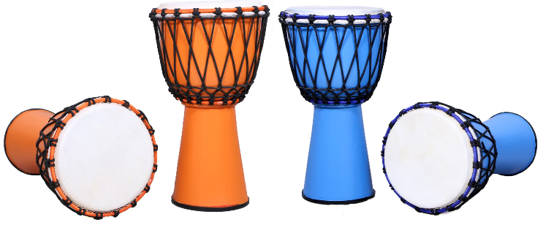
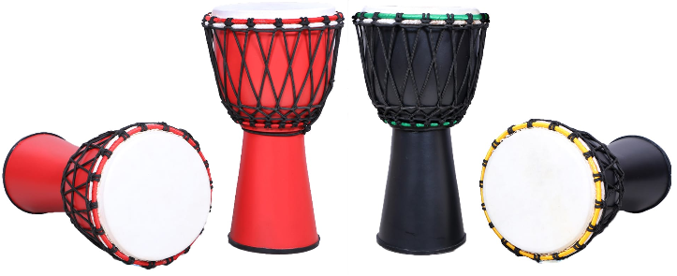
SAACH Entertainment
Where We Can Drum !!
Drum Jamming can be arrange for Private Get-Togethers, Birthdays, Anniversaries, Kitty-Parties, Corporate Co., School - Colleges Fest, Marriages, Fun Fair, and Theme-Based Gatherings
Djembe Drums !!

Slide 6
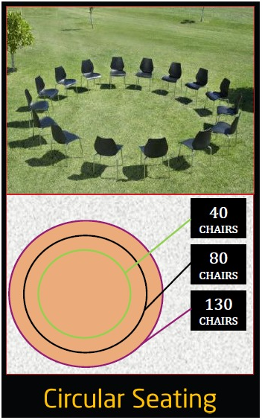
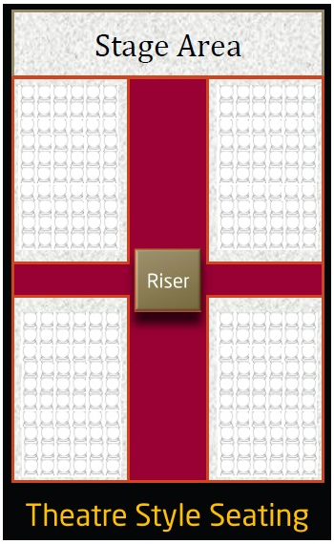
SAACH Entertainment
Seating Arrangements - Chairs without Armrest Only Or
OR

Slide 7
SAACH Entertainment
What we Required !!
We required Volunteers for arrangements & help with the unloading & loading, setting up 0f equipment's & instruments
Permission : All required permission – legal or otherwise should be taken care of by you
Sound System & Speakers If any required has to be arrange by you
Parking : Four Wheelers parking for the Team
Food & Beverage to be arrange by you for the entire Team
Our aim is to provide you the BEST then the REST
Keep Drumming ….!!

